Slide 1
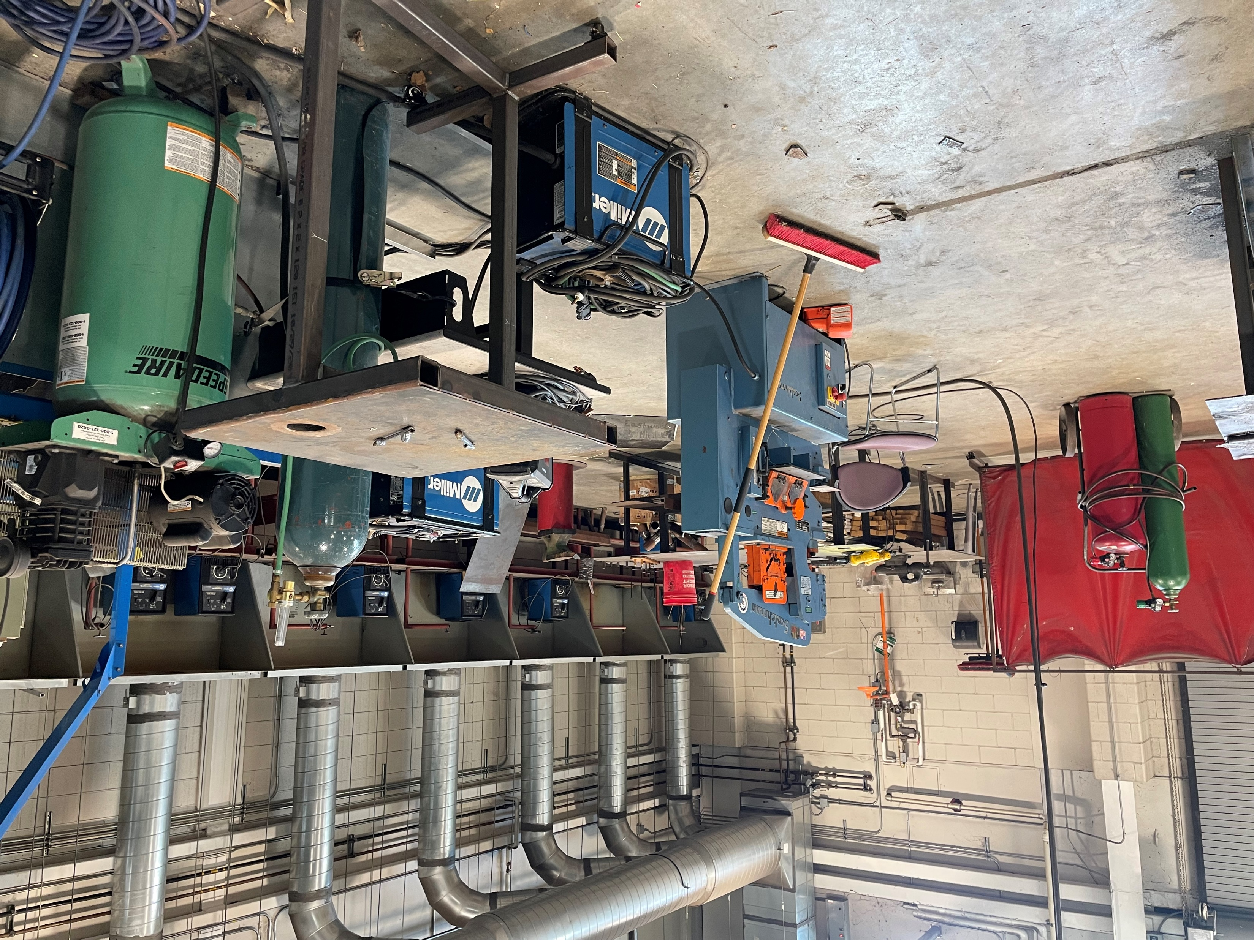
Applied Agricultural Engineering
Statewide Program of Study
Agriculture, Food, and Natural Resources Career Cluster
The Agriculture, Food, and Natural Resources (AFNR) Career Cluster focuses on the essential elements of life food, water, land, and air. This career cluster includes a diverse spectrum of occupations, ranging from farmer, rancher, and veterinarian to geologist, land conservationist, and florist. It also includes non-traditional agricultural occupations like wind energy, solar energy, and oil and gas production.
The Applied Agricultural Engineering program of study explores the occupations and educational opportunities associated with applying knowledge of engineering technology and biological science to agricultural problems concerned with power and machinery, electrification, structures, soil and water conservation, and processing agricultural products. This program of study may also include exploration into diagnosing, repairing, or overhauling farm machinery and vehicles, such as tractors, harvesters, dairy equipment, and irrigation systems.
Secondary Courses for High School Credit
1 Principles of Ag, Food, & Natural Res.
2 Agricultural Mechanics and Metal Technologies
3 Agricultural Structures Design and Fabrications
4 Agricultural Equipment Design and Fabrication
Work-Based Learning and
Expanded Learning Opportunities
Exploration Activities | Work-Based Learning Activities
Tour a farm products or machinery plant Participate in Texas FFA | Earn a welding certification Intern at a farm products or machinery plant Participate in an FFA supervised agriculture experience
Industry-Based Certifications
AWS D1.1 Structural Steel
AWS D9.1 Sheet Metal Welding
Postsecondary Opportunities
Associates Degrees
Heavy Equipment Maintenance Technology/ Technician
Agricultural Mechanization, General
Small Engine Mechanics and Repair Technology/ Technician
Welding Technology/ Welder
Bachelor’s Degrees
Agricultural Engineering
Agricultural Mechanization, General
Master’s, Doctoral, and Professional Degrees
Agricultural Engineering
Agricultural Mechanization, Genera
SMHS Ag Mechanics Shop
Aligned Occupations
Occupations | Median Wage | Annual Openings | % Growth
Outdoor Power Equipment and Other Small Engine Mechanics | $32,406 | 366 | 16%
Welders | $41,350 | 6171 | 9%
Farm Equipment Mechanics and Service Technicians | $39,915 | 304 | 17%
Mobile Heavy Equipment Mechanics | $47,299 | 1627 | 16%
Agricultural Engineers | $64,792 | 9 | 13%
Successful completion of the Applied Agricultural Engineering program of study will fulfill requirements of a Business and Industry endorsement or STEM endorsement if the math and science requirements are met. Revised – August 2022

Slide 2
Applied Agricultural Engineering Course Information
COURSE NAME | SERVICE ID | PREREQUISITES | COREQUISITES
Principles of Agriculture, Food, and Natural Resources | 13000200 (1 credit) 6100 | None | None
Agricultural Mechanics and Metal Technologies | 13002200 (1 credit) 6150 | Principles of AFNR | None
Agricultural Structures Design and Fabrications | 13002300 (1 credit) 6103 | Ag Mech & Metal Tech | None
Agricultural Equipment Design and Fabrication​ | 13002360 (2 credits)​ 6105 | Ag Structures Design & Fab​ | None​
FOR ADDITIONAL INFORMATION ON THE AGRICULTURE, FOOD, & NATURAL RESOURCES CAREER CLUSTER,
PLEASE CONTACT: CJ Odam, SMCISD CTE Coordinator cj.odam@smcisd.net
San Marcos CISD does not discriminate on the basis of race, color, national origin, sex, disability or age in its programs or activities and provides equal access to the Boy Scouts and other designated youth groups. The following person has been designated to handle inquiries regarding the nondiscrimination policies: Stephanie Munoz ; 631 Mill St, San Marcos, TX 78666 ; 512-393-6700 ; stephanie.munoz@smcisd.net
Further nondiscrimination information can be found at smcisd.net/cte

